Slide 1

CDBG Program
Request for Payment Process
Division of Administration
Office of Community Development – Local Government Assistance

Slide 2

GENERAL PRESENTATION INFORMATION
Webinar is being recorded and will be posted on our website.
Questions can be entered into the Chat.

Slide 3

IMPORTANT DATES
July 1, 2024 – Grantees received notification of the changes to the payment process.
July 8, 2024 – OCD-LGA began accepting revised Request for Payment form.
July 31, 2024 – Last day OCD-LGA will accept old Request for Payment form.
August 31, 2024 – Last day OCD-LGA will accept Requests for Payment by mail.

Slide 4
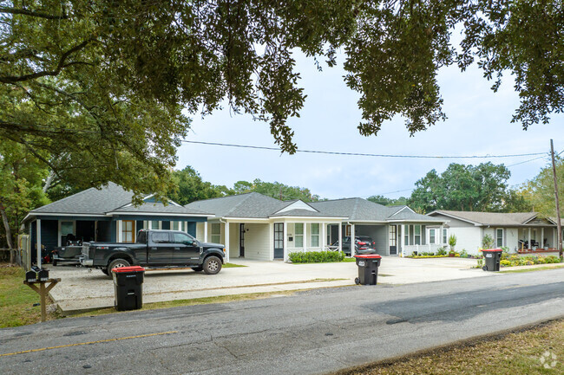

ELIGIBLE ACTIVITIES
The “Authorization to Incur Costs, Application Revisions, and Grant Agreement Transmittal” letter included the activities that are funded in your grant.
OCD-LGA cannot approve reimbursement for activities that are not included in the grant.
Any penalties incurred or budget changes made will alter what is listed in the letter.

Slide 5
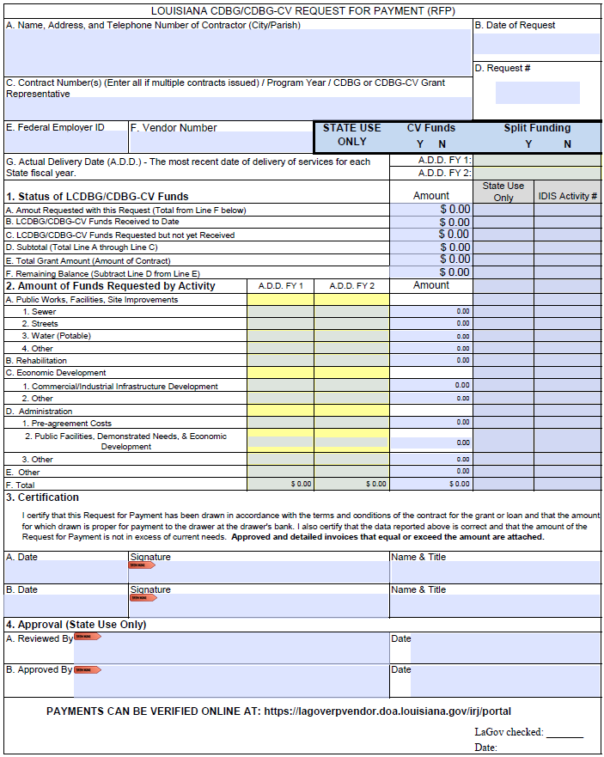
Updated RFP form.

Slide 6
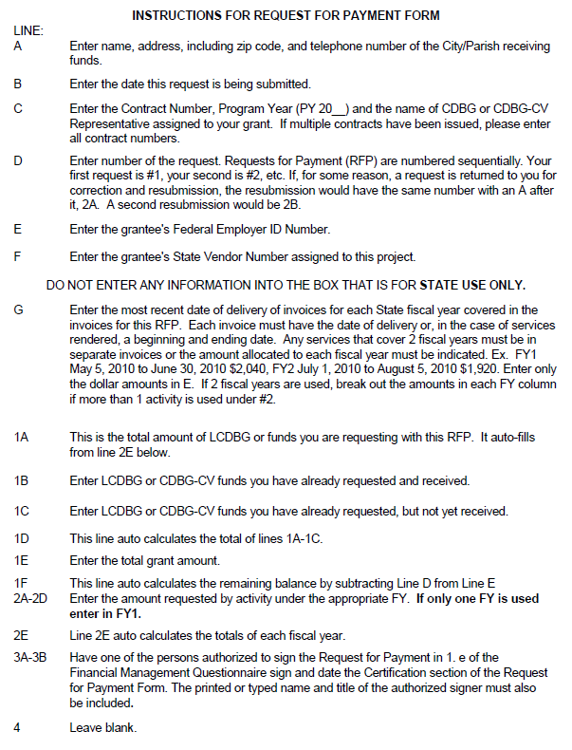
Instructions for updated RFP form.

Slide 7
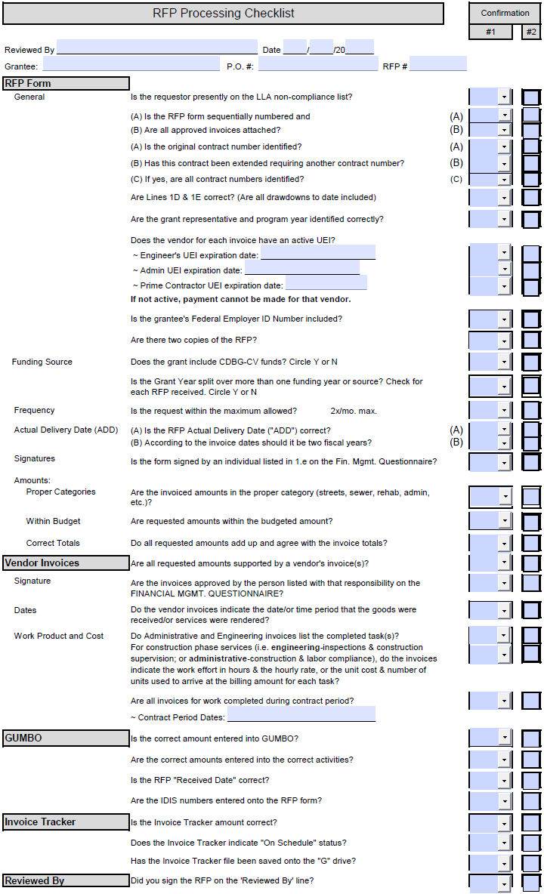
Checklist used by OCD-LGA Staff to review RFPs for processing.

Slide 8
NEW REQUEST FOR PAYMENT PROCESS (1 of 2)
The preferred method for receiving Request for Payment (RFP) forms is email.
Each RFP must be emailed to the following to ensure timely processing: 1) your grant representative; 2) kayla.cole@la.gov; 3) denease.mcgee2@la.gov; and 4) janelle.dickey@la.gov.
Each RFP form must be signed by one of the persons identified on the approved Financial Management Questionnaire (FMQ) form.
OCD-LGA will no longer require the Authorized Signature Form or use this form when processing RFPs.
Approved invoices must be included with the RFP form.
The RFP form should by signed digitally if at all possible. Please note, Adobe Reader is available for free download; this will enable you to digitally sign all forms requiring a signature.
RFPs must be emailed or delivered by Wednesday at 4:30 PM in order to be considered for payment the following week.

Slide 9
NEW REQUEST FOR PAYMENT PROCESS (2 of 2)
All grantees should set up their vendor ID to accept payments through electronic funds transfer (EFT). If you have not done so already, contact the Office of Statewide Reporting and Accounting Policy (OSRAP) at _DOA‐OSRAP‐EFT@la.gov or 225‐342‐1097 for the EFT enrollment form. This form designates where the funds will be deposited. The completed form should be sent directly to OSRAP. It takes approximately 14 days to process a revision so please do this immediately. If there is any reason that you are not able to set up an ID to accept payments by EFT, please reach out to Janelle Dickey at janelle.dickey@la.gov.
A separate, non-interest bearing checking account is still required, unless the grantee has received written permission from our office authorizing an alternative to this.

Slide 10

ADDITIONAL PROGRAM REQUIREMENTS (1 of 2)
All grantees must have UEI number actively registered in www.SAM.gov .
All engineers, consultants, and prime contractors must have UEI number actively registered in www.SAM.gov .

Slide 11

Additional Program Requirements (2 of 2)
Reimbursement of professional service contractors must adhere to the requirements of 2 CFR 200.459 “Professional Service Costs”.
As authorized in the contract between the grantee and the professional service contractor, the vendor must identify the task or description of the service provided, the effort (in hours), the hourly rate of compensation, as well as the nature and amount of expenses, in order to sufficiently describe the work product performed.
Cost plus a percentage of cost and percentage of construction cost methods of contracting must not be used.

Slide 12
RESOURCES
OCD – LGA Website
https://www.doa.la.gov/doa/ocd-lga/
Office of Statewide Reporting and Accounting Policy (OSRAP)
https://www.doa.la.gov/doa/osrap/
Adobe Acrobat Reader - Free
https://get.adobe.com/reader/

Slide 13

Online Demonstration

Slide 14

Reminders
Email your completed RFP to the OCD-LGA.
Make sure you email the documents to Kayla Cole, Denease McGee, Janelle Dickey, and your grant representative.
After July 31, 2024, only the revised RFP form will be accepted.
After August 31, 2024, only emailed Requests for Payment will be accepted.
We are here to help!

Slide 15

Questions

Slide 16
Contact Information (1 of 2)
OCD – LGA
  Traci Watts, Director traci.watts@la.gov 225-342-0148
  Heather Paul, Assistant Director heather.paul@la.gov 225-342-7418
  Kayla Cole, OCD-LGA staff kayla.cole@la.gov 225-342-7412
  Janelle Dickey, OCD-LGA staff janelle.dickey@la.gov 225-219-7278
  Denease McGee, OCD-LGA staff denease.mcgee2@la.gov 225-342-7530

Slide 17
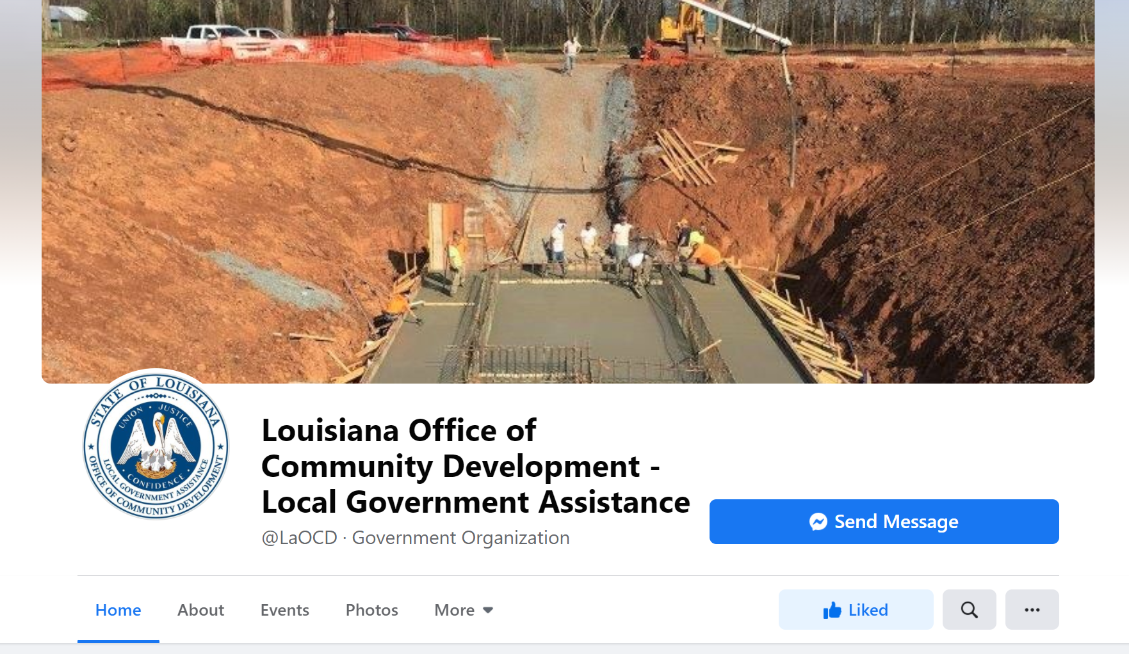
Contact Information (2 of 2)
Follow us on Facebook to receive reminders and notifications about programs!

Slide 18

THANK YOU!

